Slide 1

R.L.JALAPPA INSTITUTE OF TECHNOLOGY
Instant news with enhanced journalism towards Digital India
Under the Guidance of :
Mr. Madhukar H
Asst Professor
Dept of CSE
By: Akash J (1RL13CS002)
Arvind M (1RL13CS007)
Karthik S(1RL13CS022)
Sharath Pawan(1RL13CS038)

Slide 2
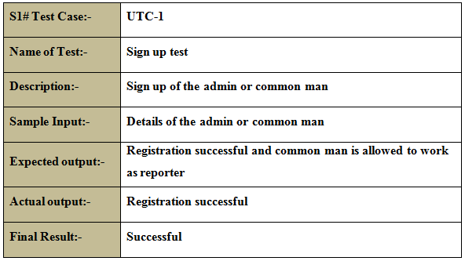
Test Case Analysis

Slide 3
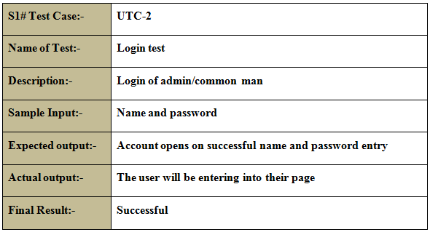
Test Case Analysis (Contd…)

Slide 4
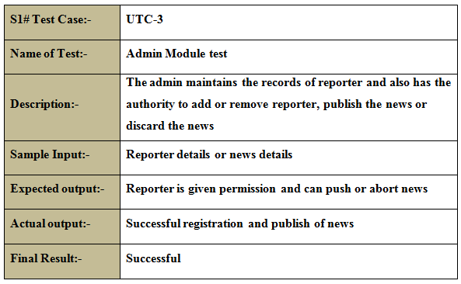
Test Case Analysis (Contd…)

Slide 5
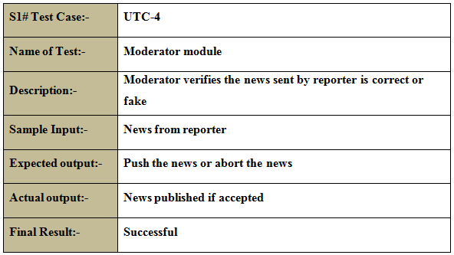
Test Case Analysis (Contd…)

Slide 6
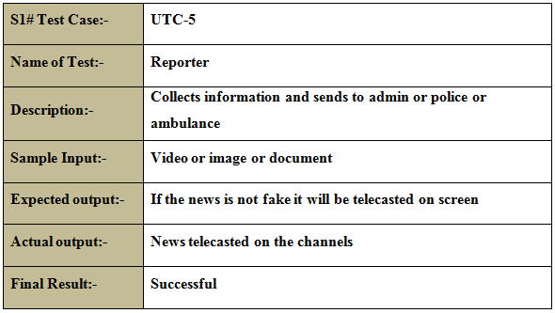
Test Case Analysis (Contd…)

Slide 7
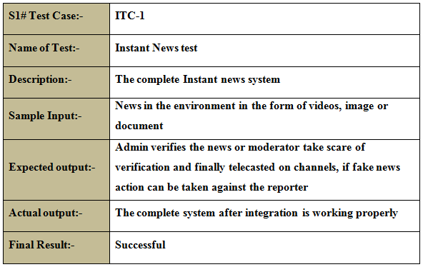
Test Case Analysis (Contd…)

Slide 8
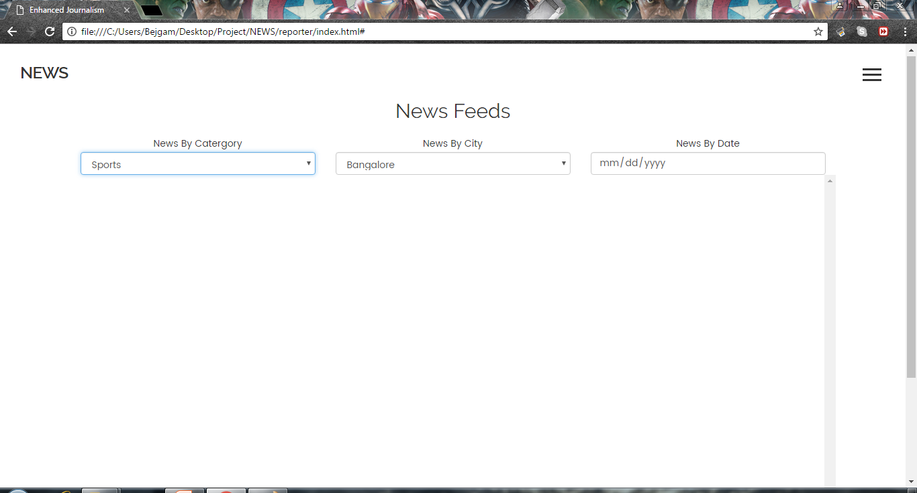
News Feeds

Slide 9
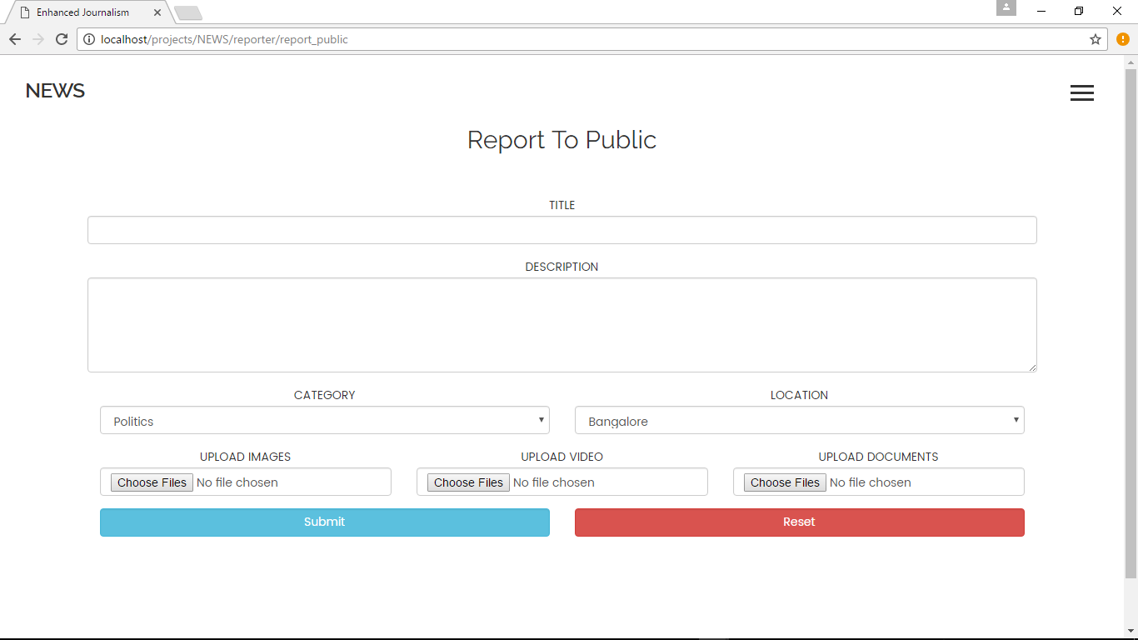
Upload the feed

Slide 10
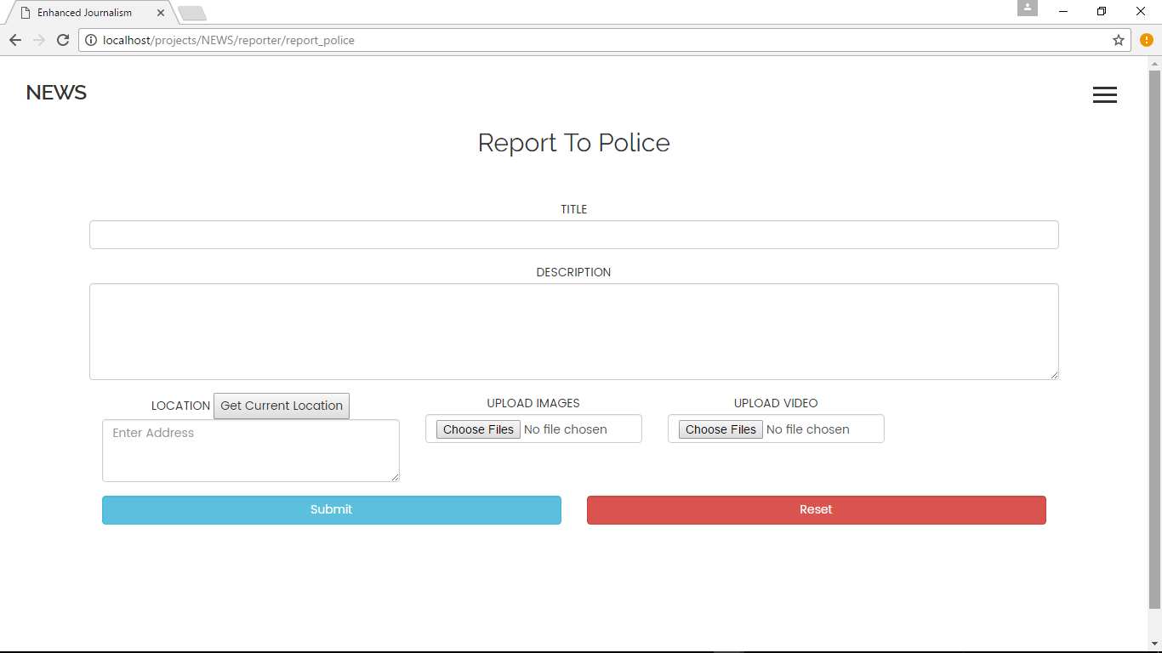
Direct the feed to police

Slide 11
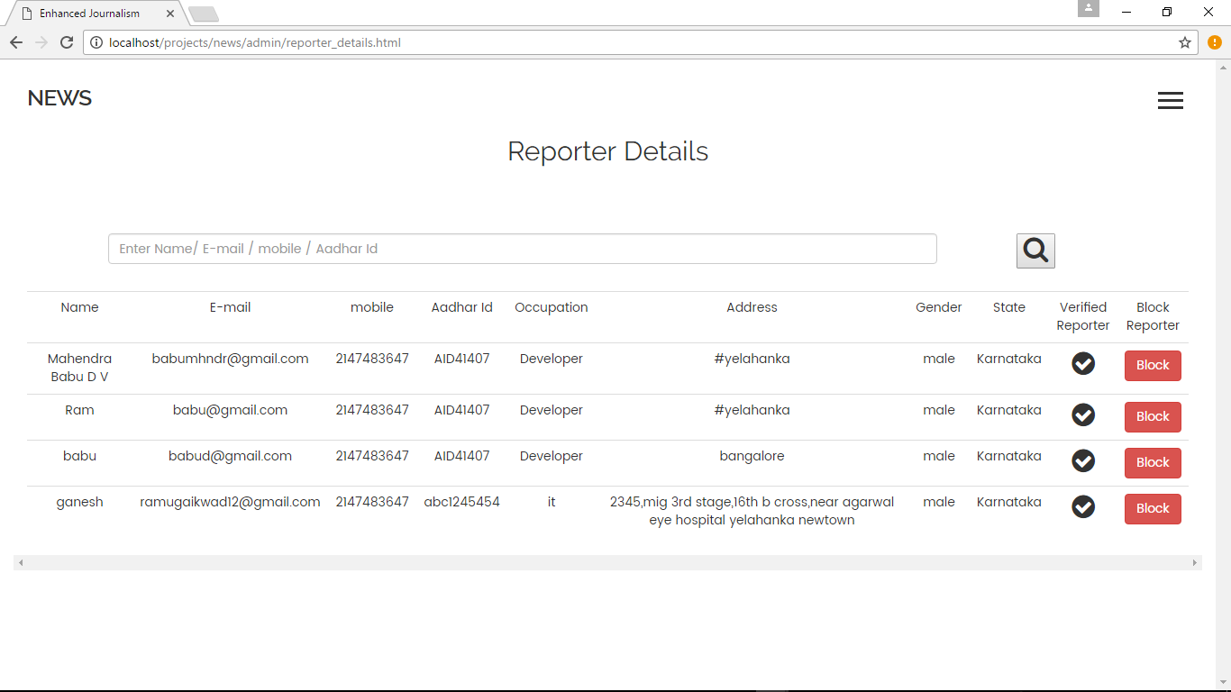
Reporter Details (Accessible only by Admin)

Slide 12
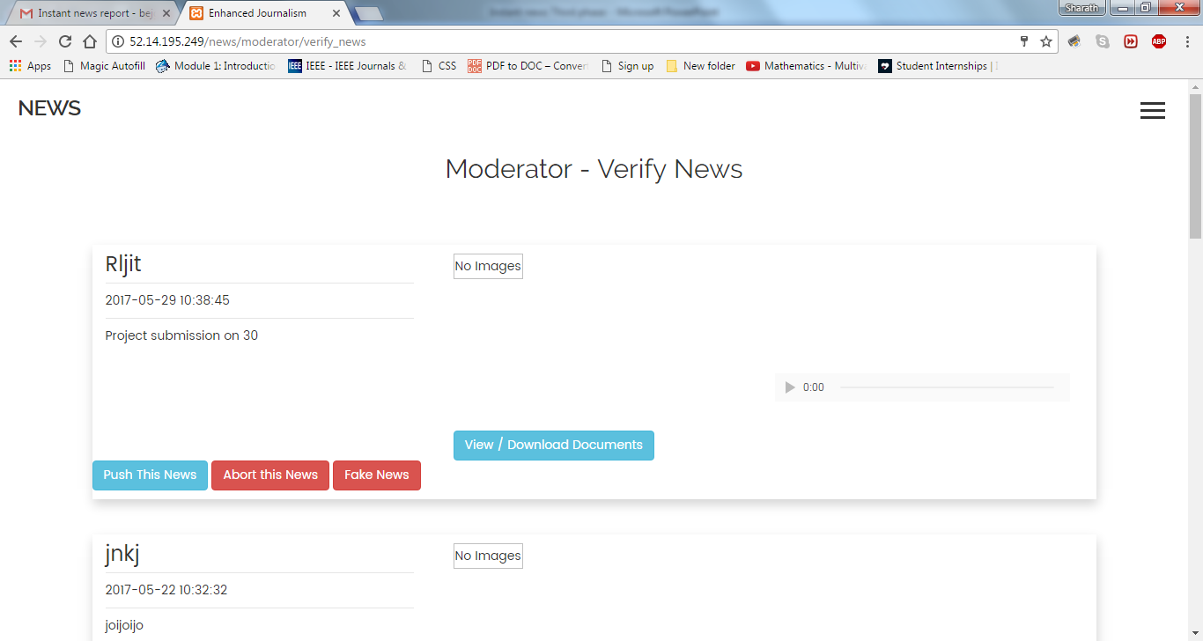
Verify News(Moderator End)

Slide 13
Conclusion and Future Enhancement
This project has discussed industry developments in various countries based on studies using quantitative audits and surveys as well as interview-based case studies.
These studies with mixed methodologies provide various insights into the changing perceptions and actions relating to the production of instant news. The posited model of journalism offers an analytical framework for future research into the dynamics at play between humans and technology in the salient case of customizing or repurposing journalism.
The instant news also helps in identification of crime and helping the people in case of emergency by providing ambulance feature. This also helps in getting the news all over the world instantly.
This application can be enhanced in future to provide women safety, ambulance services, etc which would even more help our society.

Slide 14
Thank You

